Slide 2
ALL ABOUT JHARKHAND
A continuative approach regarding enhancement of Jharkhand state
Presented by :-SHASHI JAISWAL
Guided By : NEENA JHA

Slide 3
Some Why and how?
Why this App?
Sectors it benefits
How it benefits
Project scalability

Slide 4
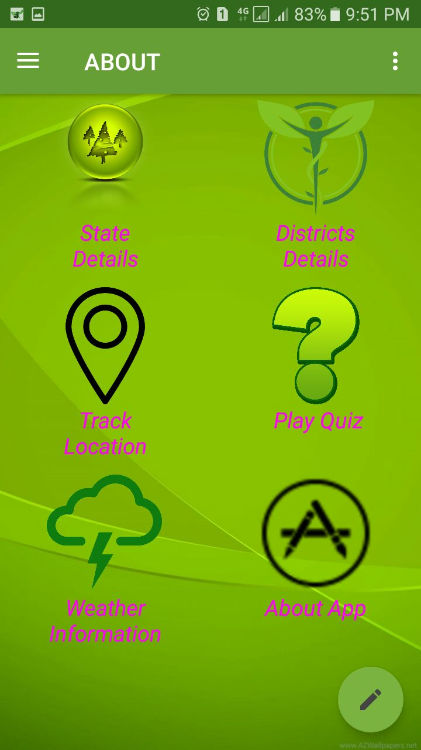
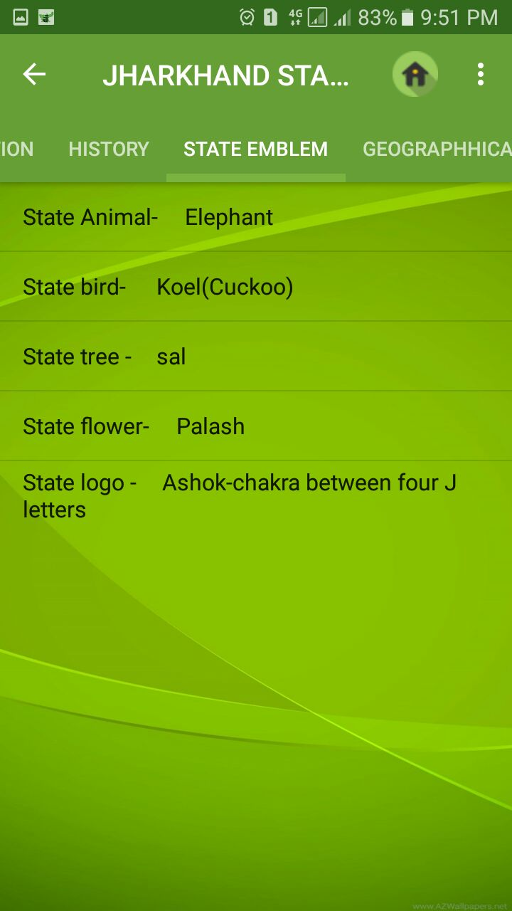

Slide 5
OBJECTIVE
empower people to add voice regarding development of Jharkhand state
to facilitate people with all demographical & non demographics information
providing details of nearby location of essential places like hotel, schools and others
a quiz to check Jharkhand knowledge

Slide 6
TECHNICAL SKILLS:
1) Android Studio
2) Java programming.
3) CSS, PHP knowledge.
4) SQL Based database

Slide 7
Different types of screen used
Splash Screen
Navigation drawer
Grid view
Option menu
Floating menu
List view
Web-view

Slide 8
Some technical terms used
Json
Volley
Random function
Timer function
Weather API
Location API

Slide 9
Transmitting Network Data Using Volley
Volley offers the following benefits:
Automatic scheduling of network requests.
Multiple concurrent network connections.
Transparent disk and memory response caching with standard HTTP cache coherence.
Support for request prioritization.
Cancellation request API. You can cancel a single request, or you can set blocks or scopes of requests to cancel.
Ease of customization, for example, for retry and back off.
Strong ordering that makes it easy to correctly populate your UI with data fetched asynchronously from the network.
Debugging and tracing tools.

Slide 10
DFD LEVEL 0
Query
State Info
ask
retrive
District Info
retrive
ALL ABOUT JHARKHAND
USER
interact
retrive
Weather info
play
feed
Quiz
FeedBack

Slide 11
DFD LEVEL 1
Play store
ALL ABOUT JHARKHAND
Can be downloaded
Local host
Store database
District Info
Query
Ask query related to
USER
State Info
Ask query related to
District Info
FeedBack
Give feedback about
State Info
Give feedback about

Slide 12
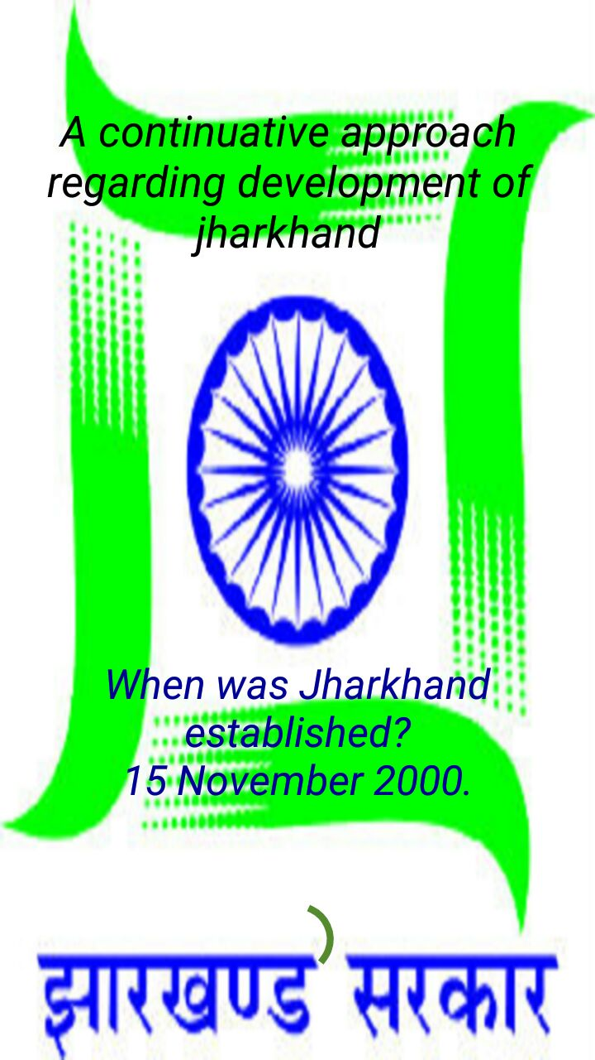
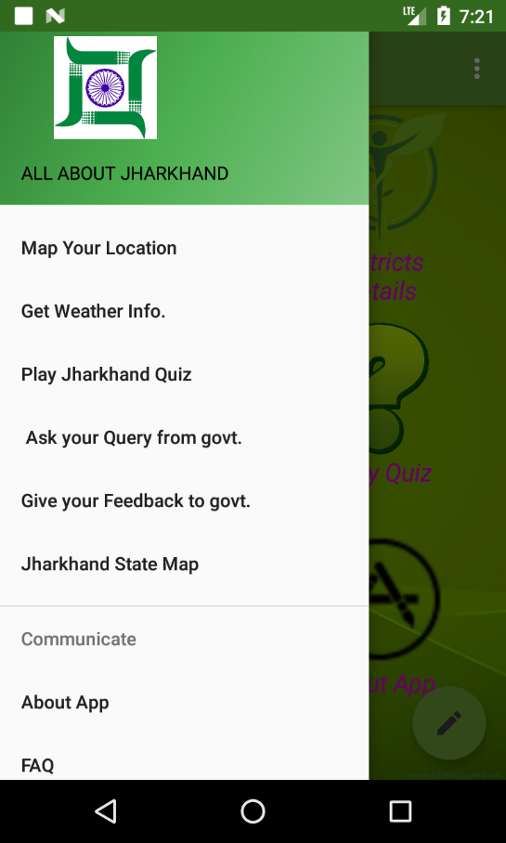

Slide 13
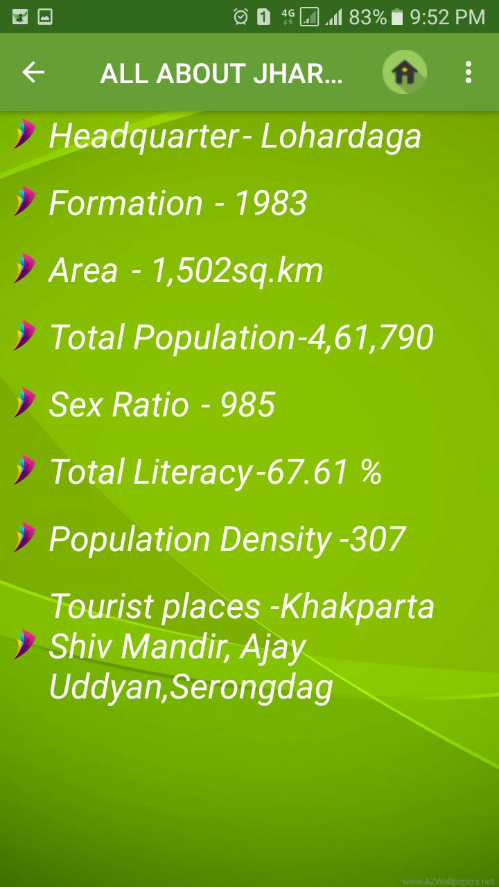
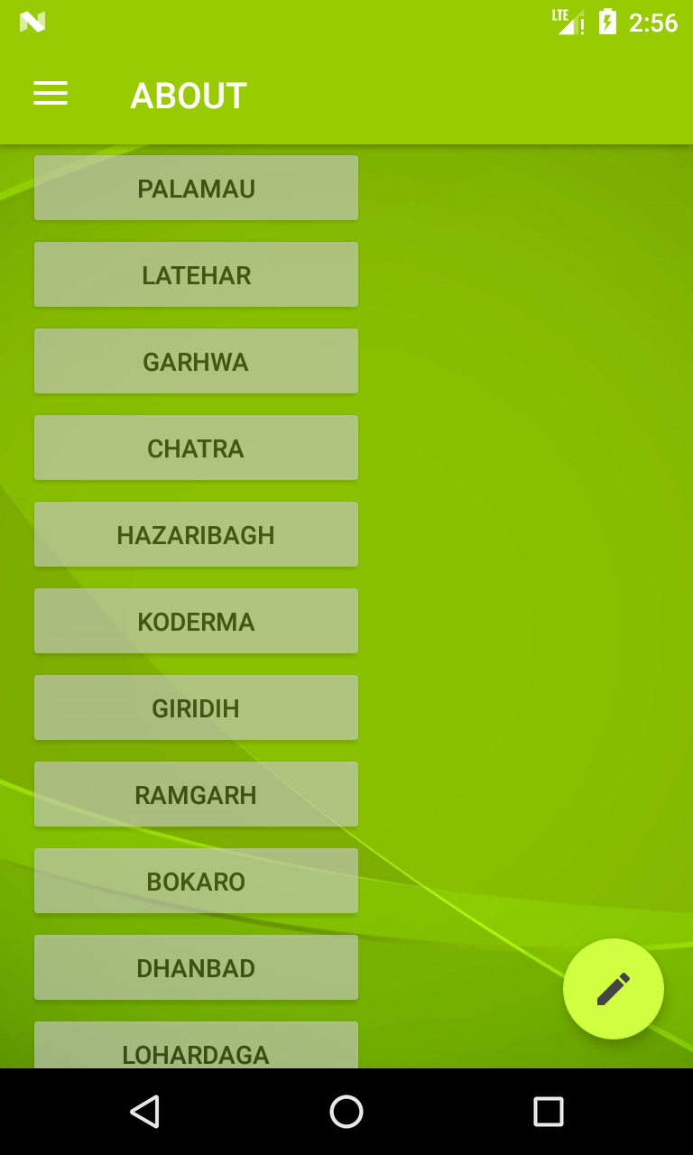
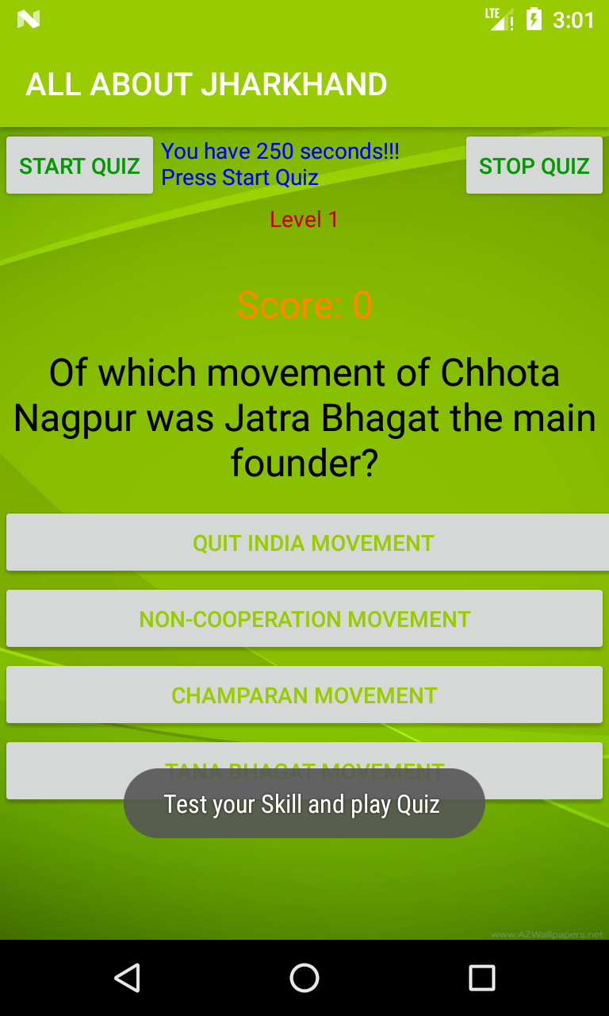
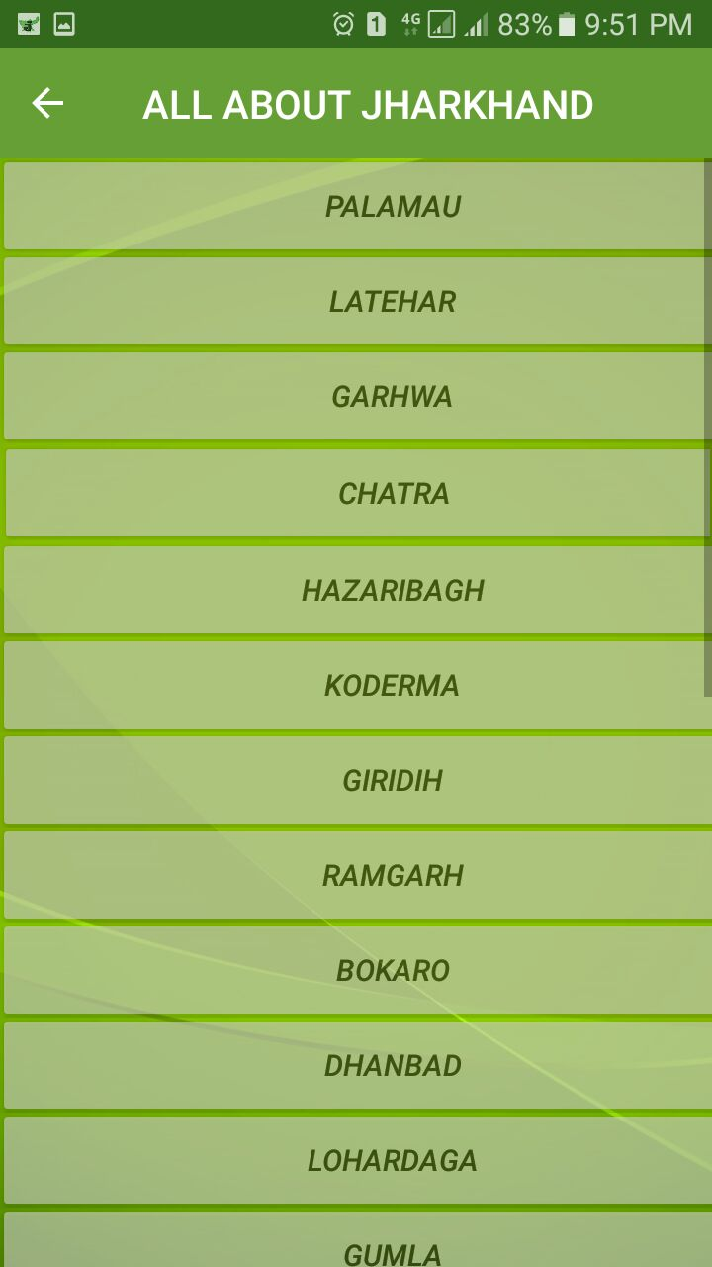

Slide 14
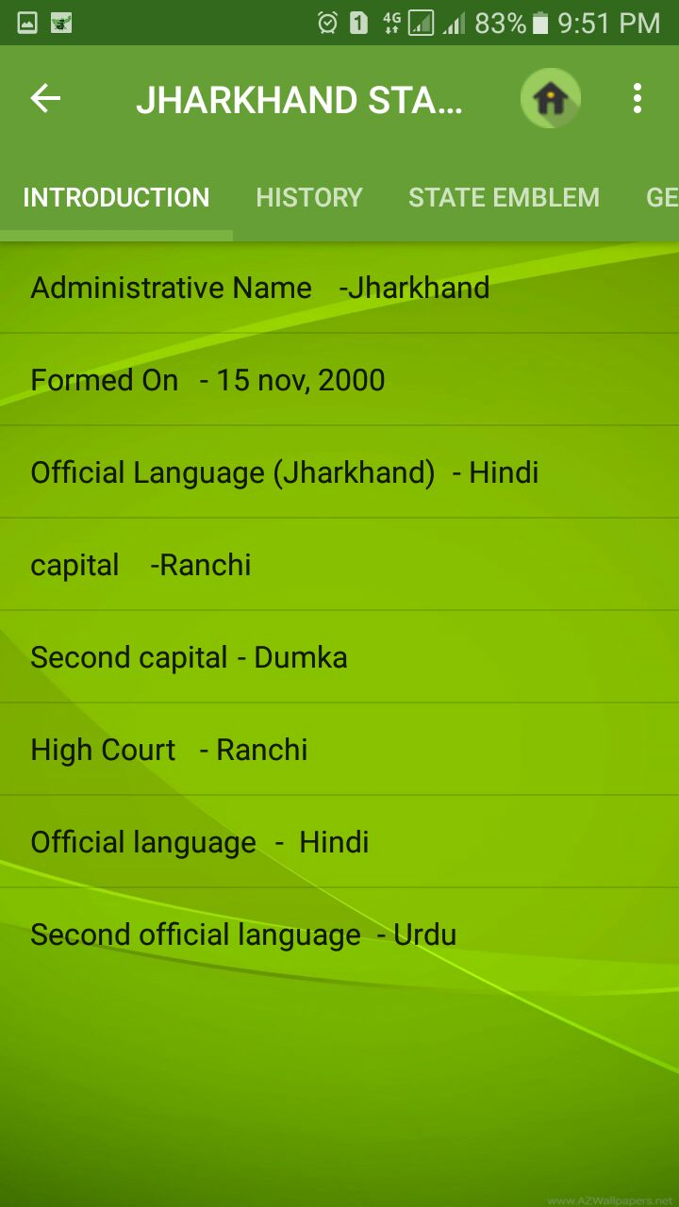
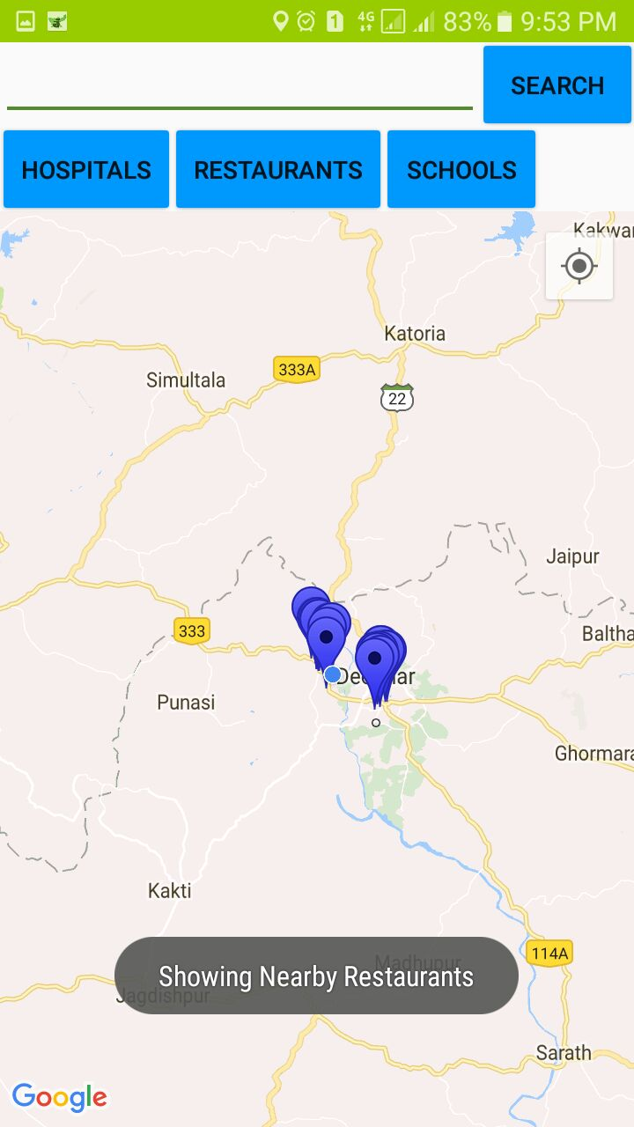
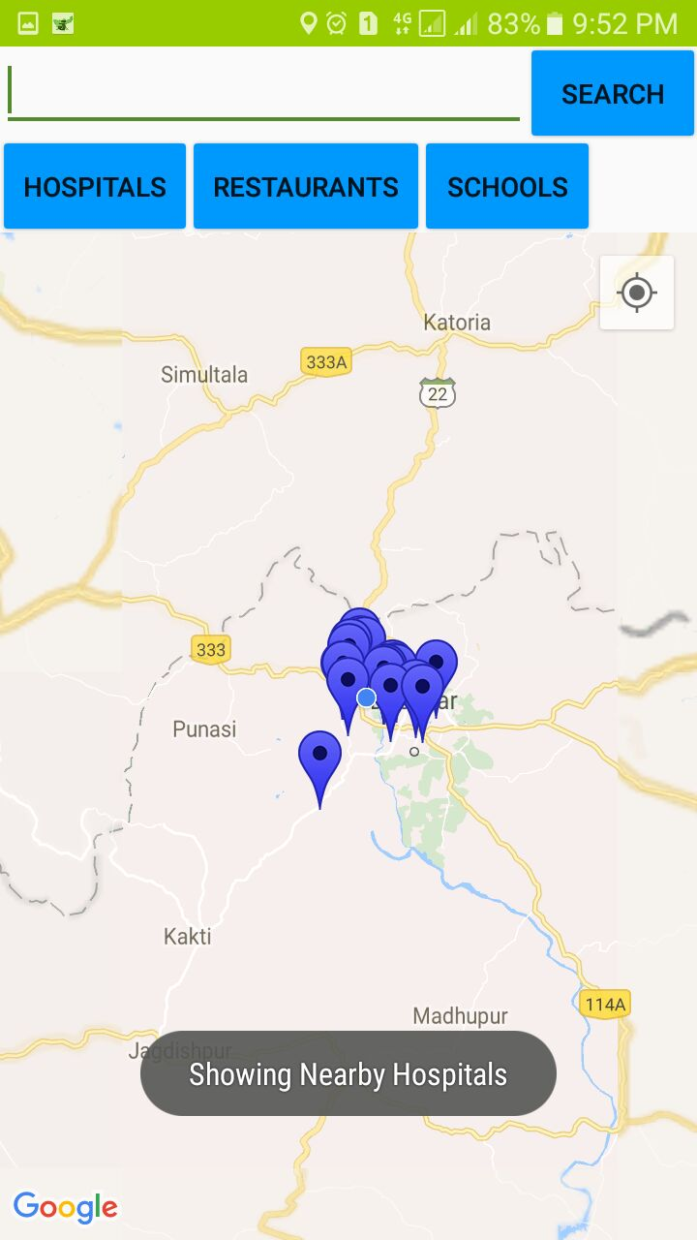
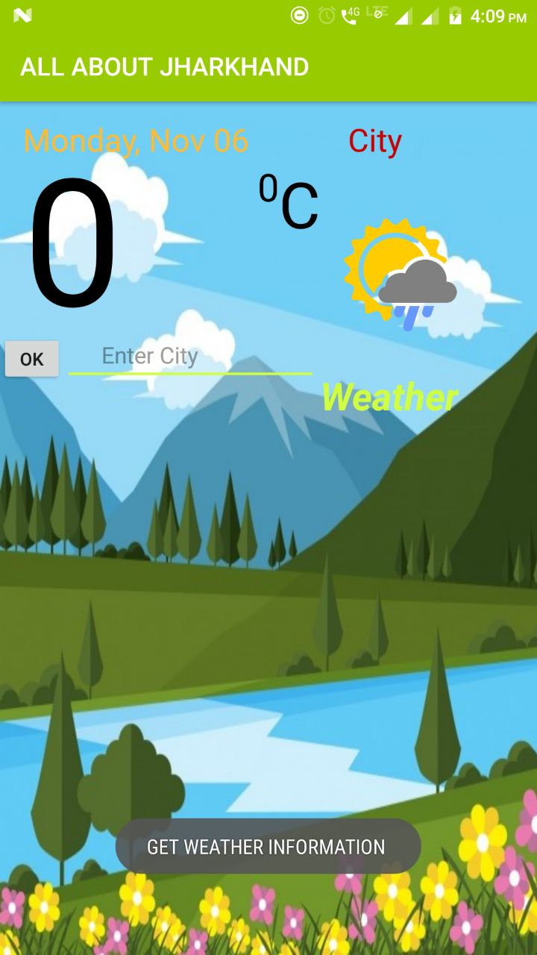
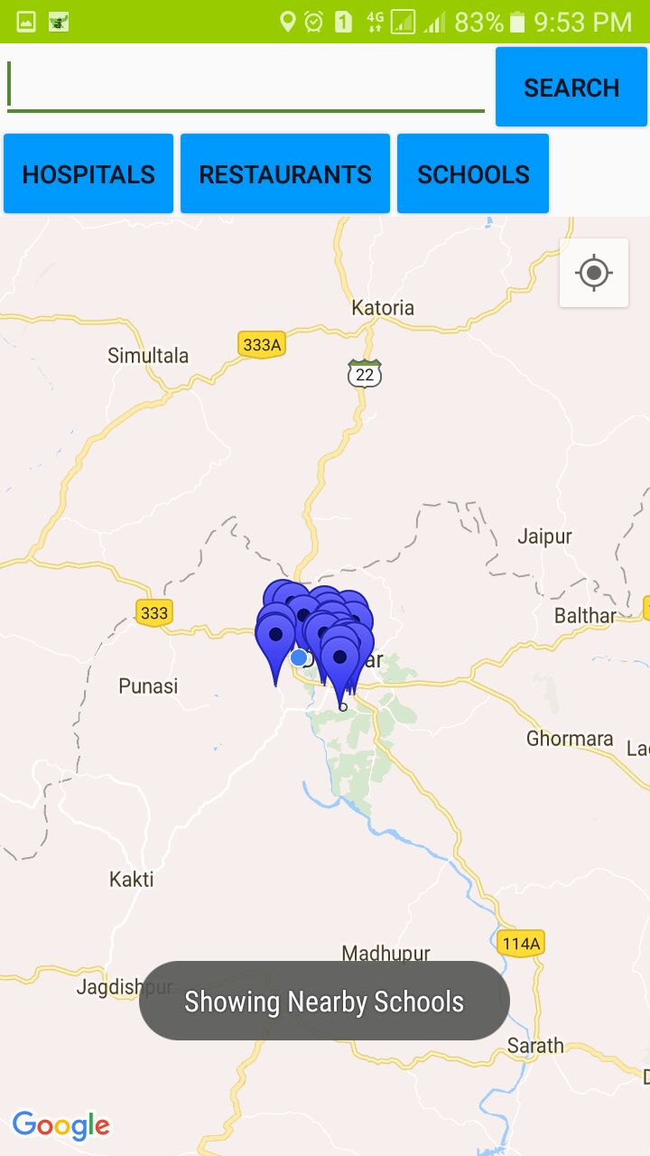
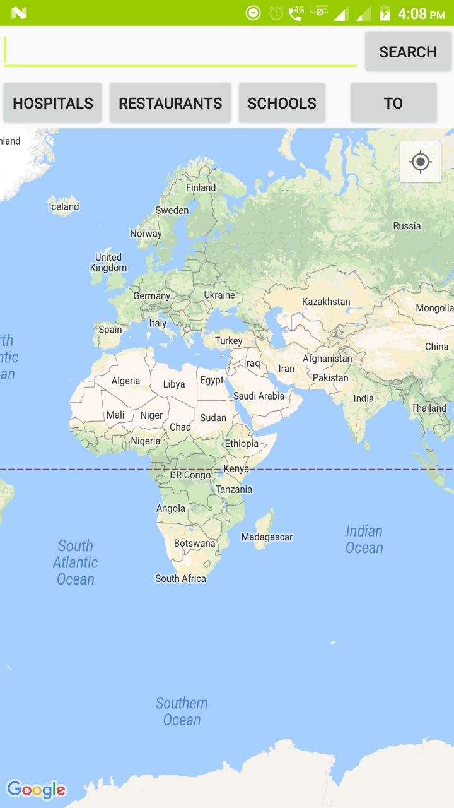
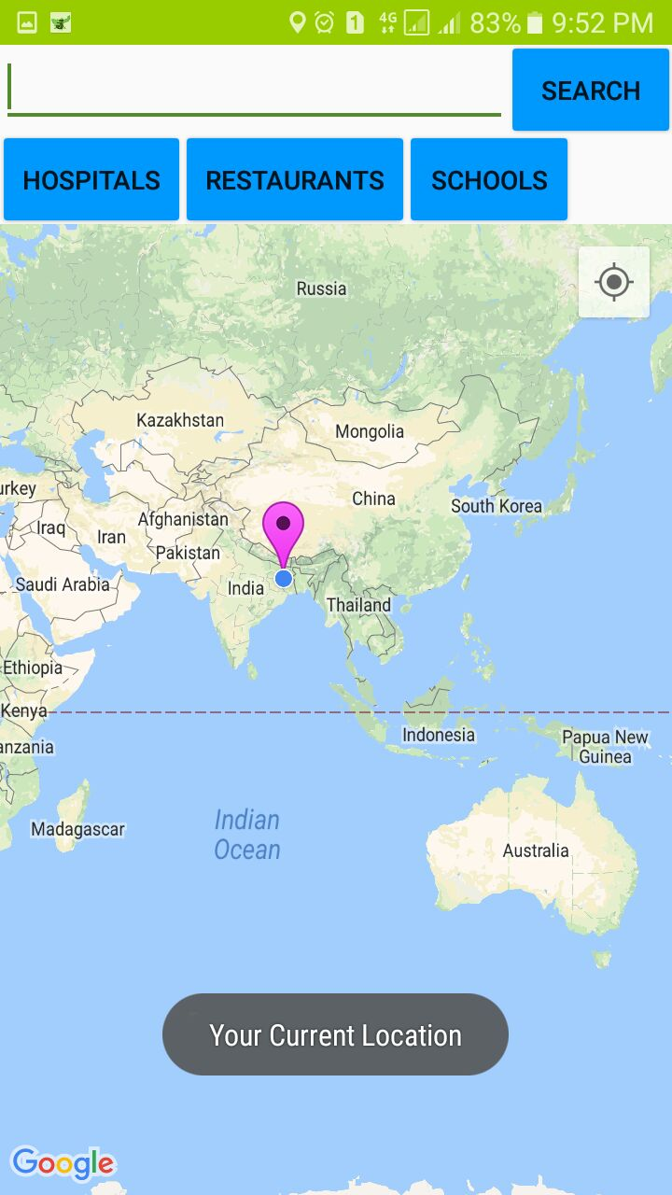

Slide 15
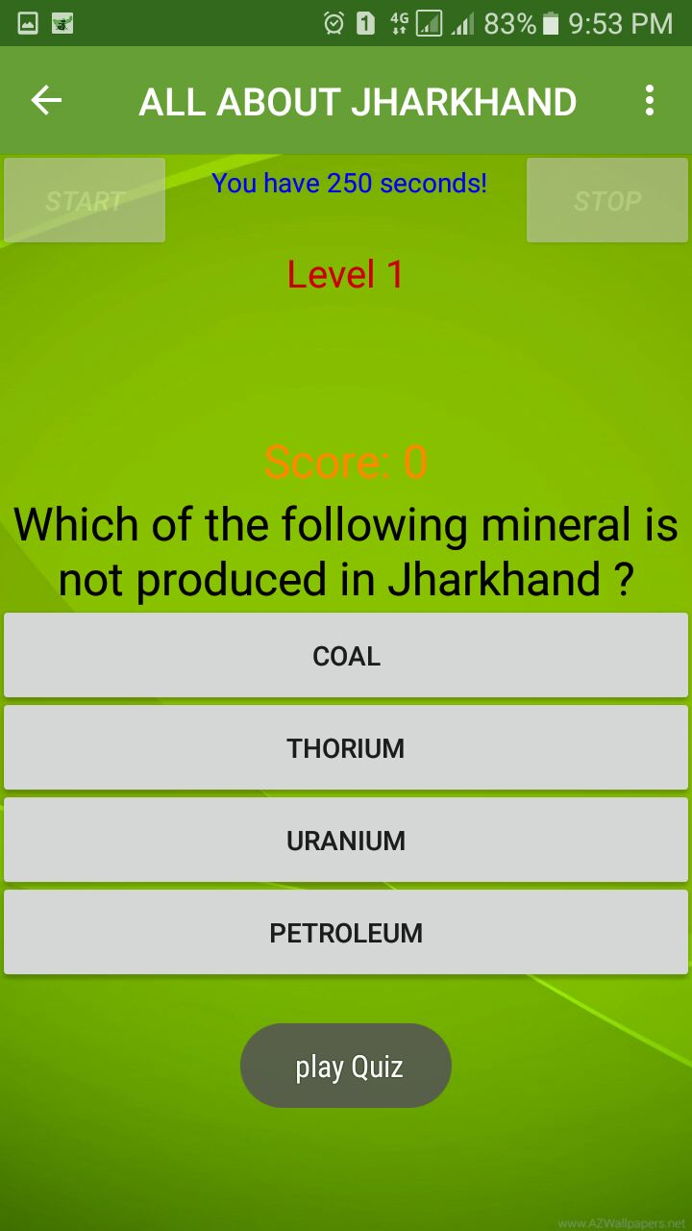
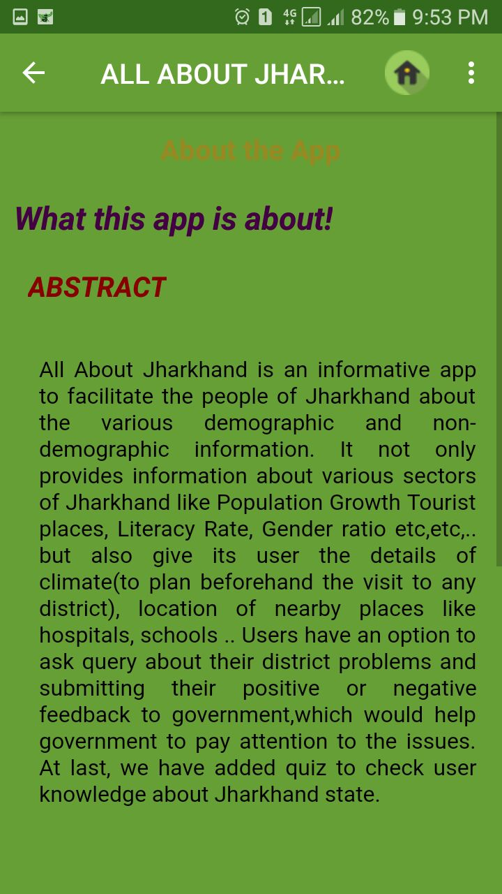
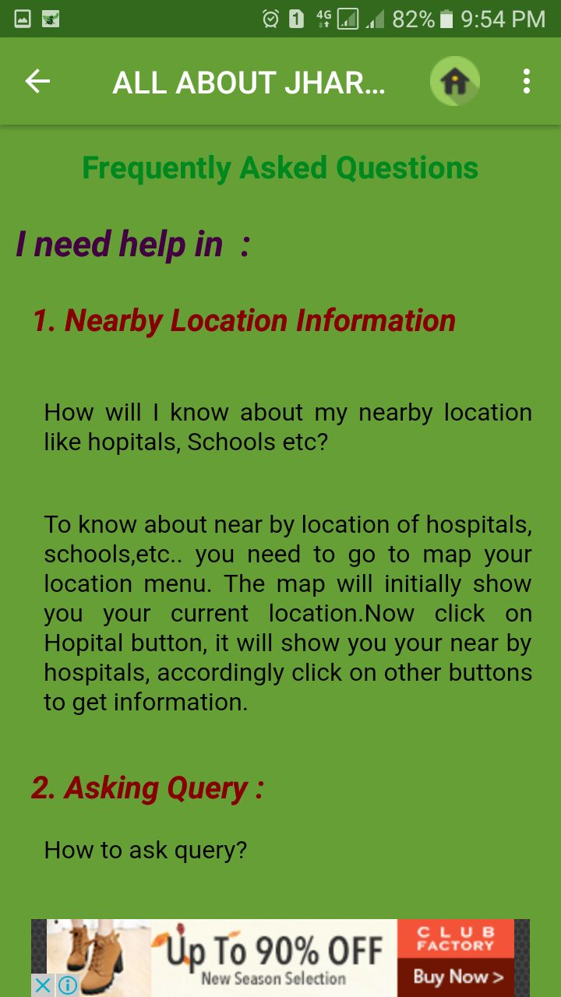

Slide 16
FUTURE SCOPE
We are contacting with Jharkhand govt to make this app official
If implemented correctly it could turn out to be a “time & effort” saving alternative.
It comparatively simple, useful and at the same it is scalable.
It even has the potential to replace the diverse apps which hardly provide any information all together.
Submission of ideas by people can bring a drastic change in development of this state.

Slide 17
Thank you
Shashi.jaiswal17@gmail.com

Slide 18
Questions?

